Slide 1
Optimizing Trading Strategies with Reinforcement Learning
Amulya Saxena
Travis Desell

Slide 2
Agenda – Stand up I
Update
Code Commits
Experiments

Slide 3
Update
Mid July – researched and documented next steps for fall semester
End Aug – Started studying and coding momentum-based strategies
Mid Sept – Experimenting with Moving averages and Relative strength index
Notes:
The only hold up is that, I need to see a lot of videos understanding the technical terms
- As each strategy is different and involves different components

Slide 4
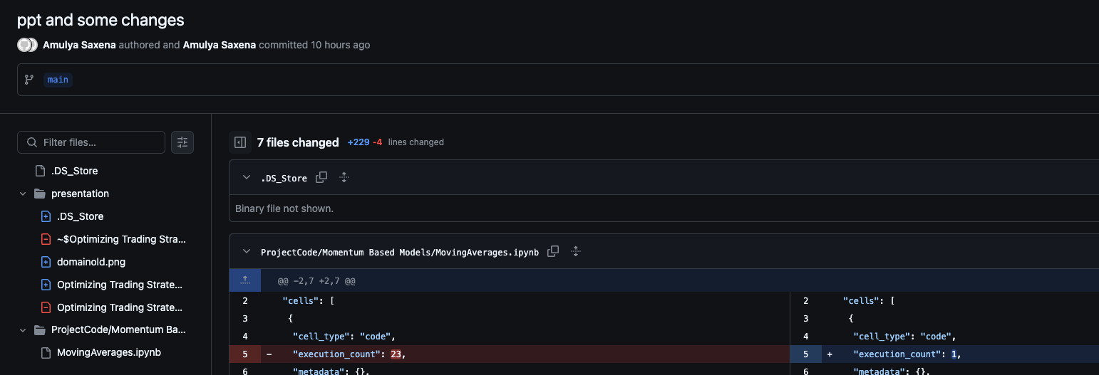
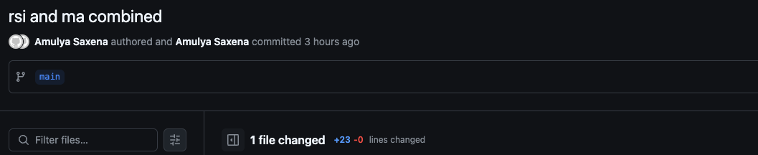

Slide 5
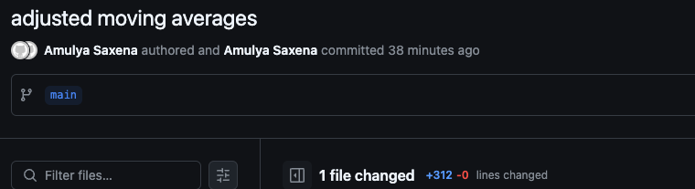

Slide 6
Experiments
Optimized Moving average windows
RSI lookback period optimization
Tested in Different Market Regimes

